Slide 1
There Are No Millenial Cobol Programmers
Safety Margins and Availability (and FMEA)
Why I pay silverfoxprod.com to make nice animations
Adrian Cockcroft
@adrianco

Slide 2
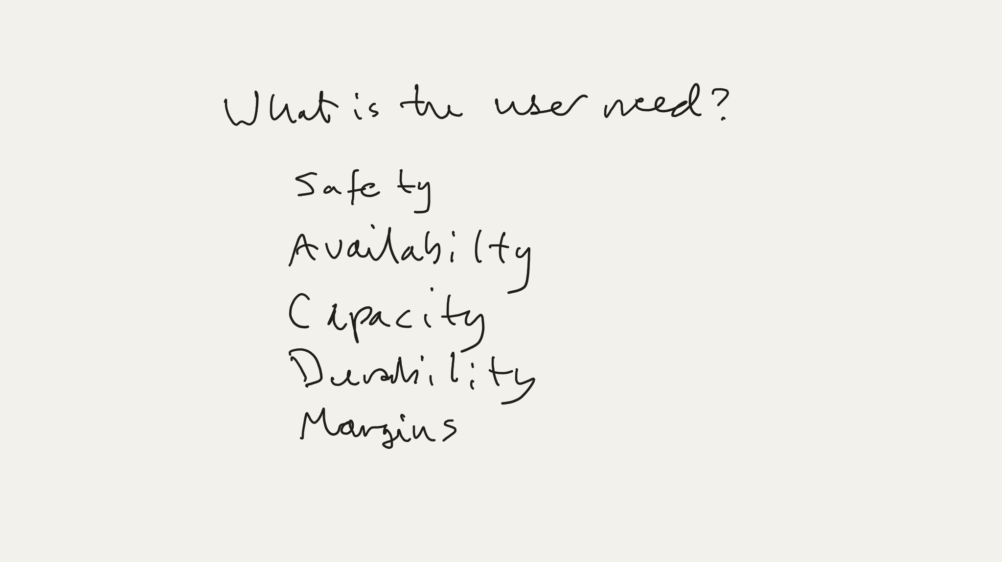

Slide 3
Safety
Availability
What is the User Need?
Capacity
Durability
Margins

Slide 4
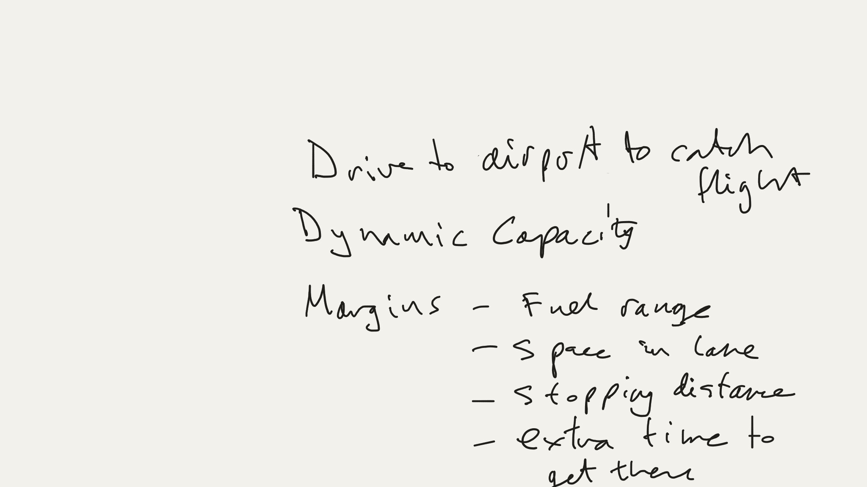

Slide 5
Safety
Availability
What is the User Need?
Drive to the Airport to Catch a Flight
Capacity
Durability
Margins

Slide 6
Margins
Fuel range
Drive to the Airport to Catch a Flight
Stopping distance
Space in lane
Dynamic Capacity
Extra time to get there

Slide 7
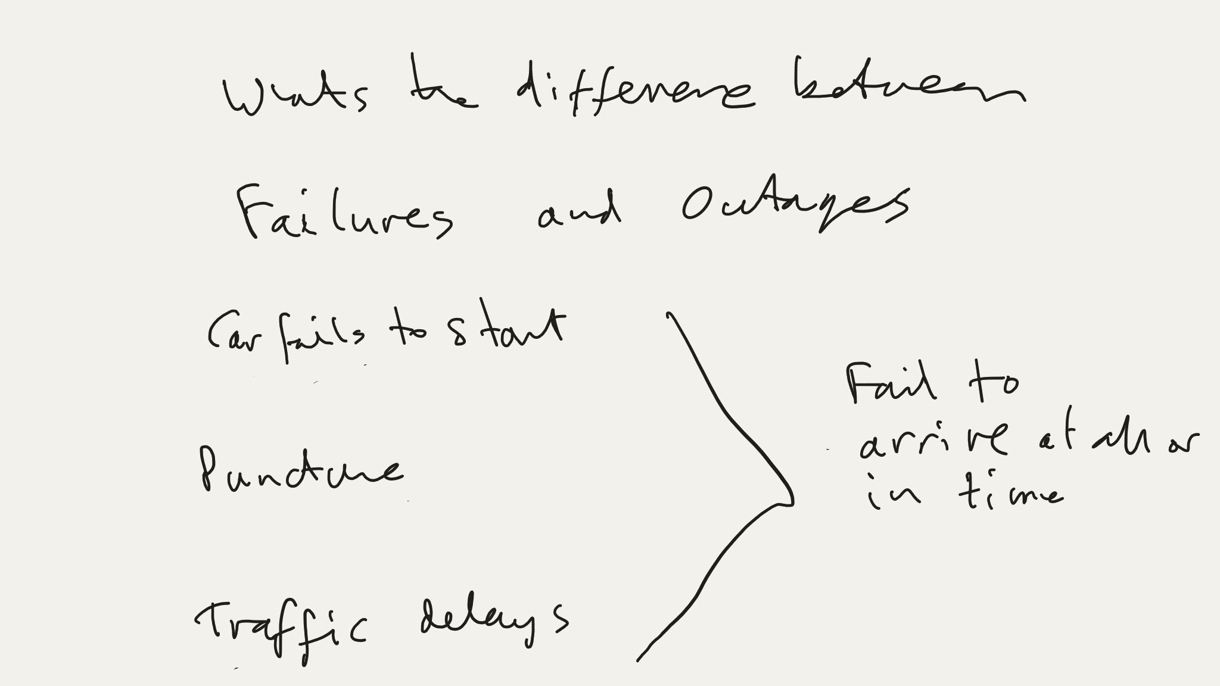

Slide 8
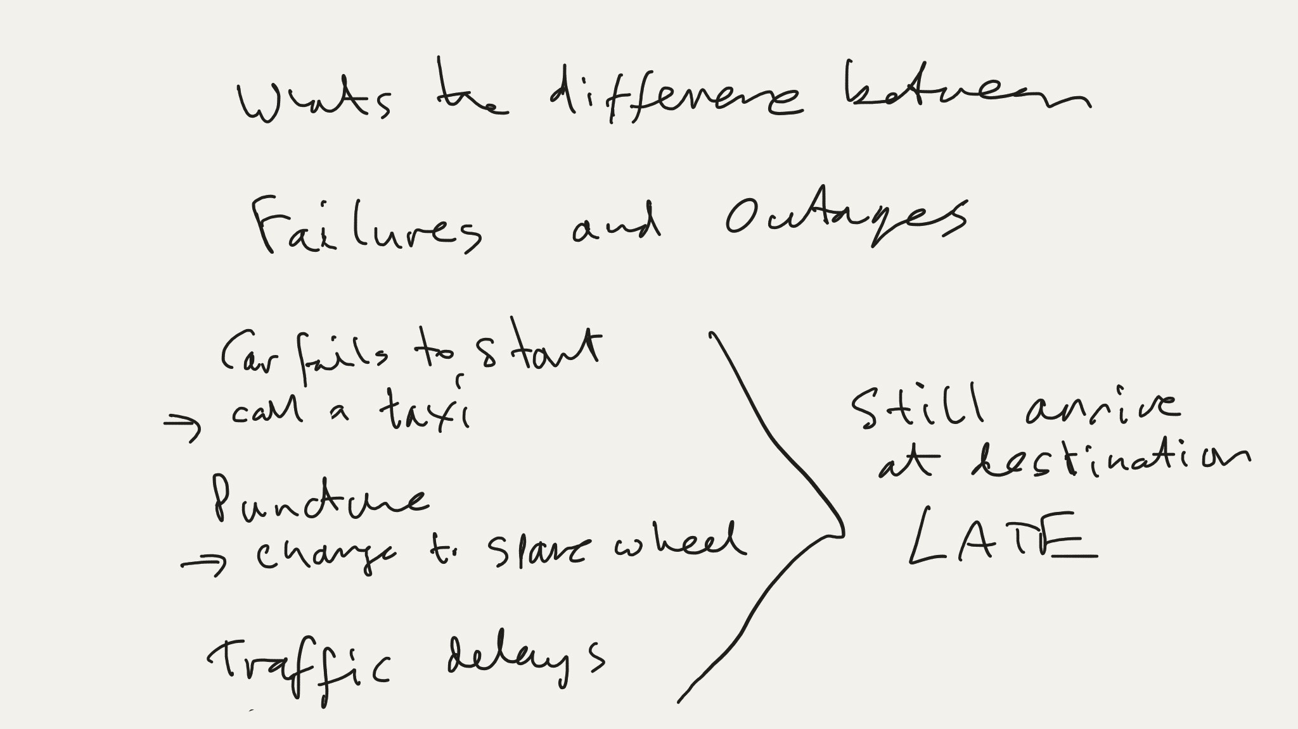

Slide 9
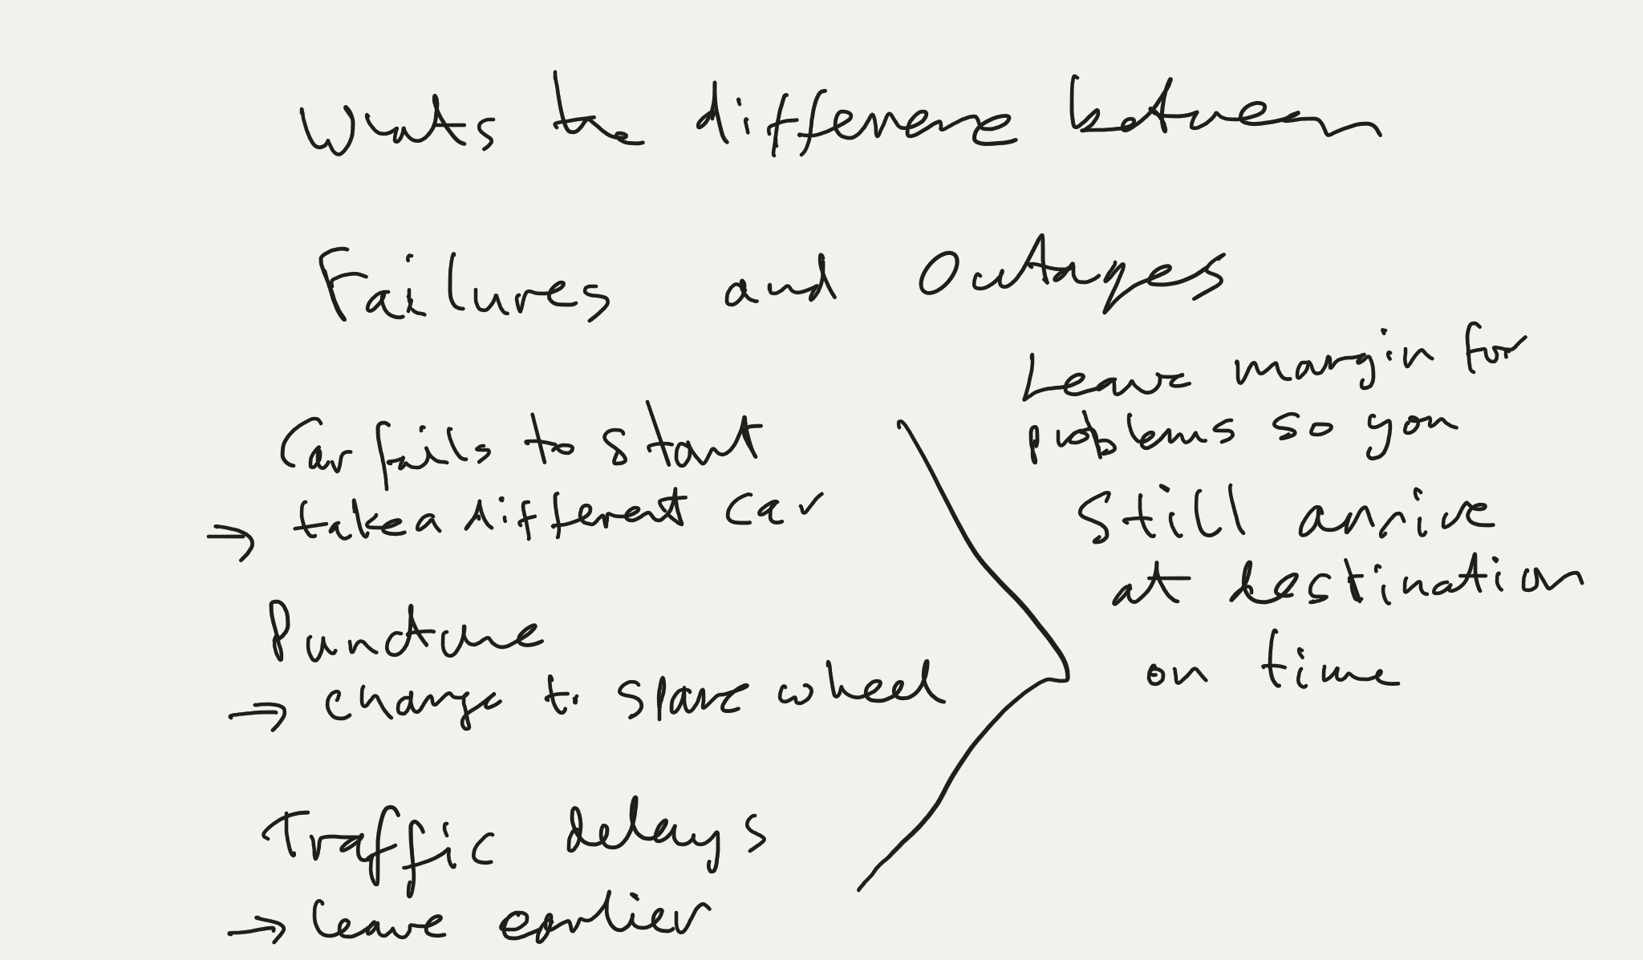

Slide 10
What is the Difference Between
Failures
and
Outages
Car fails to start
Puncture
Traffic delays
Fail to arrive at all or on time

Slide 11
What is the Difference Between
Failures
and
Outages
Call a taxi
Spare wheel
Car fails to start
Puncture
Traffic delays
Still arrive at destination late

Slide 12
What is the Difference Between
Failures
and
Outages
Call a taxi
Spare wheel
Leave earlier
Car fails to start
Puncture
Traffic delays
Leave margin for problems so you can still arrive on time

Slide 13
Puncture
Probability of a
Tire
in a
Assume 1 every 4,000 miles

Slide 14
Puncture
Failure
Probability of a
Tire
Spare Tire
in a
Car
Assume 1 every 4,000 miles
4 tires (assume independent)
1 every 1,000 miles

Slide 15
Puncture
Probability of a
Failure
with a
Spare Tire
Car
What is the probability of a puncture while the spare is being used?
100
1000
Spare used
100 miles
Tire fixed
10X better
Total probability of
1 in 10,000 miles
What difference does a spare tire make?

Slide 16
Real-world Failures and Mitigations
Spare tire is flat
Too hard to change tire
Punctures are co-related Sharp stuff on the road causes multiple punctures
Can of fix-a-flat that is cheaper, lighter, smaller, and easier to use
Mobile phones provide an alternative to call for help

Slide 17
How to Measure and Report
Availability over time?
Or over successful operations?
Monolithic failure Anything goes wrong and it’s down

Slide 18
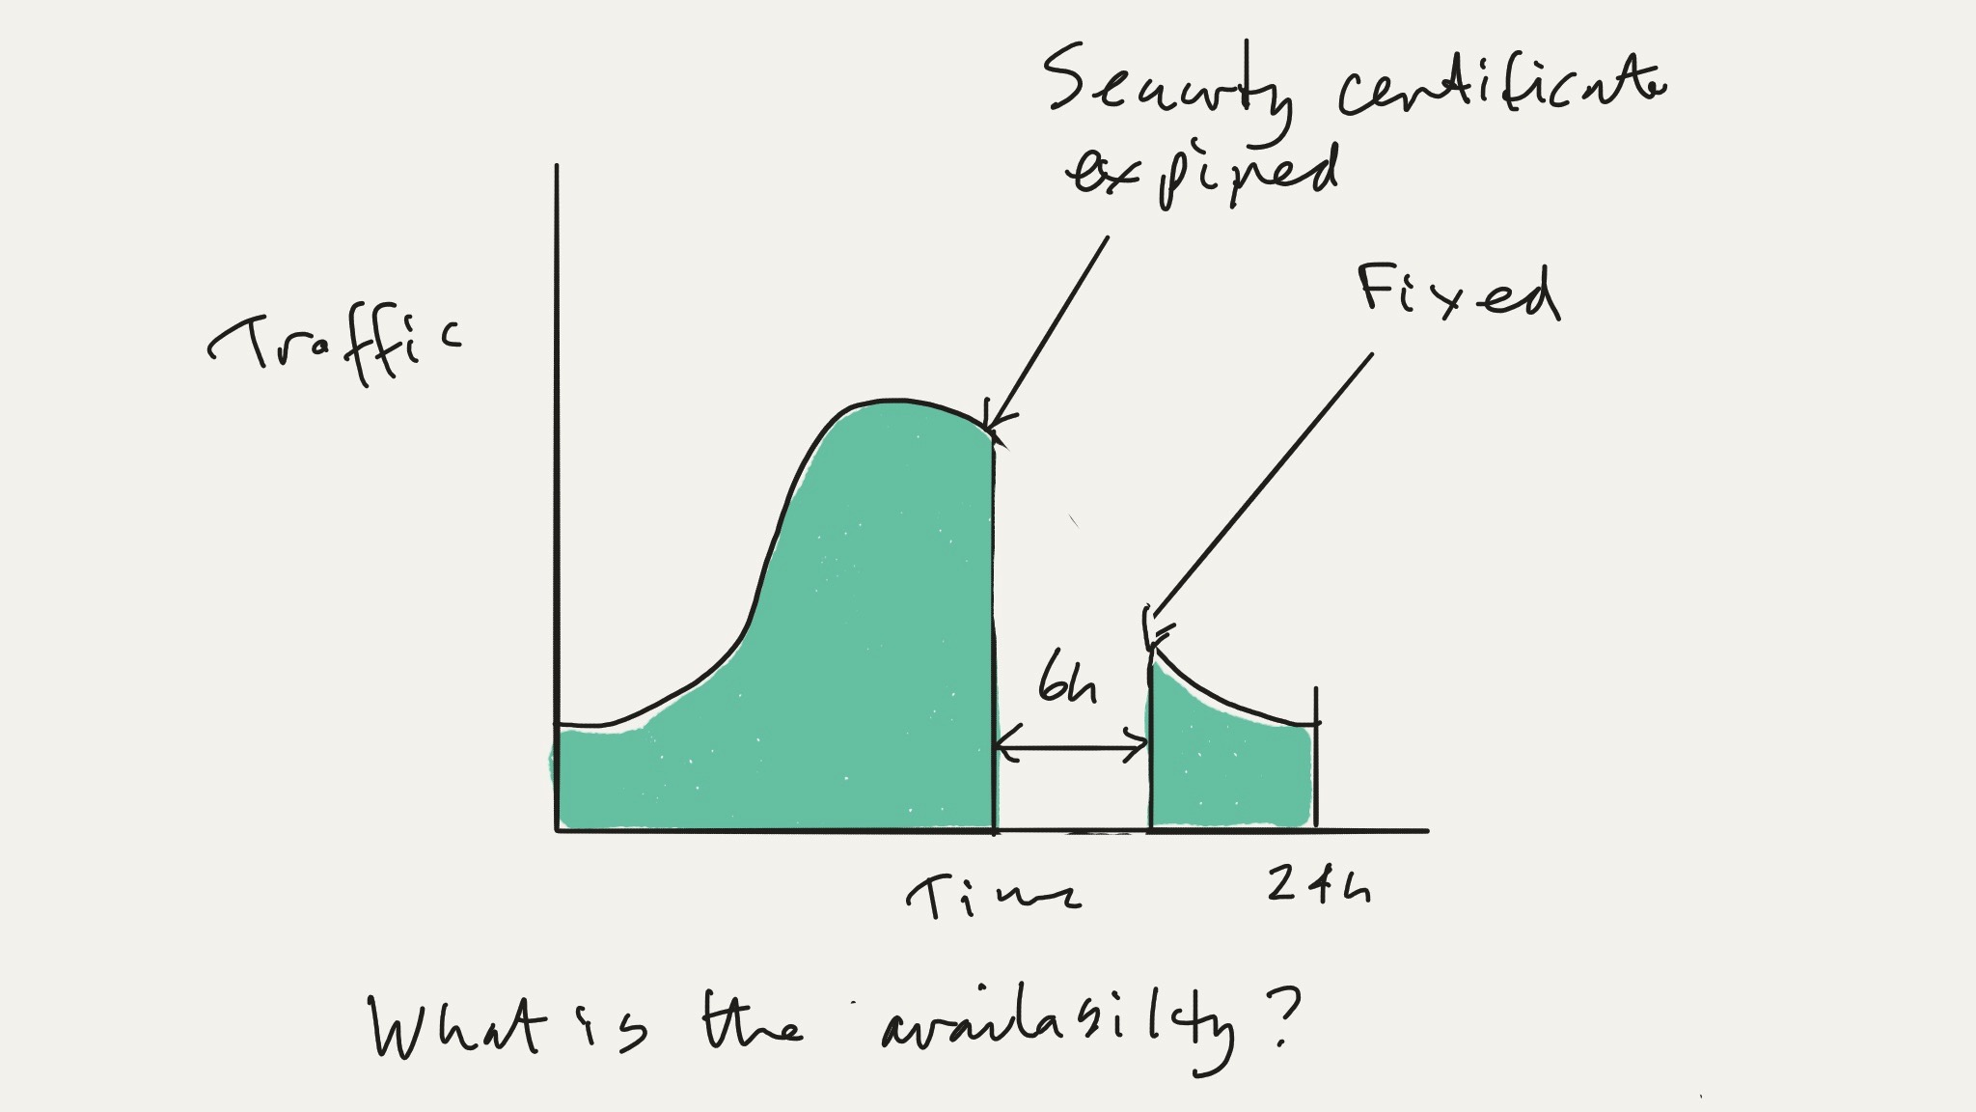

Slide 19
Traffic
24 hours
Time

Slide 20
Traffic
Security certificate expired
Fixed
24 hours
6 hours
Time
What is the availability?

Slide 21
Traffic
Security certificate expired
Fixed
24 hours
6 hours
Time
24 - 6
18
Availability for this day
75 %
24
24

Slide 22
Traffic
Security certificate expired
Fixed
24 hours
6 hours
Time
168 - 6
162
Availability for this week
96 %
If this is the only failure
168
168

Slide 23
Minor Math Rant… Split the Difference Between 90% and 99%
Traffic
Security certificate expired
Failures
Fixed
0.9
0.10
Compare
0.95?
0.05
0.99
0.01
24 hours
6 hours
Time
2x as good as 90%
Half a 9 is 7
So 95% availability is
168 - 6
162
97%
Availability for this week
5x worse than 99%
0.96
If this is the only failure
168
168

Slide 24
Traffic
Security certificate expired
Fixed
24 hours
6 hours
Time
720 - 6
Availability for this month (30 x 24 = 720 )
99 %
If this is the only failure
720

Slide 25
Traffic
Security certificate expired
Fixed
24 hours
6 hours
Time
8760 - 6
Availability for this year
0.9993
If this is the only failure
8760

Slide 26
Traffic
Security certificate expired
Fixed
24 hours
6 hours
Time
What is the success rate?

Slide 27
Traffic
Security certificate expired
Fixed
24 hours
Time
What is the success rate?
Green area vs. red area—depends on time of day—not 75%

Slide 28
Customers care more about success than availability
success
availability
Developer and business oriented
Operations and infrastructure oriented
Business-driven DevOps— use success rate not time to drive availability

Slide 29
Traffic
1000
Issue starts
Errors returned or lost traffic
Issue ends
Success
24 hours
Time
Measure difference between what is seen and what is expected

Slide 30
Traffic
1000
Issue starts
Errors returned or lost traffic
Issue ends
Success
24 hours
Time
Needs an “expected traffic” algorithm

Slide 31
Traffic
1000
Issue starts
Errors returned or lost traffic
Issue ends
Success
24 hours
Time
Partial failures
Perfect availability over time, but success rate is impacted

Slide 32
Traffic
1000
Issue starts
Errors returned or lost traffic
Issue ends
Success
24 hours
Time
Partial failures
Area of divided by area of gives successful request weighted un-availability

Slide 33
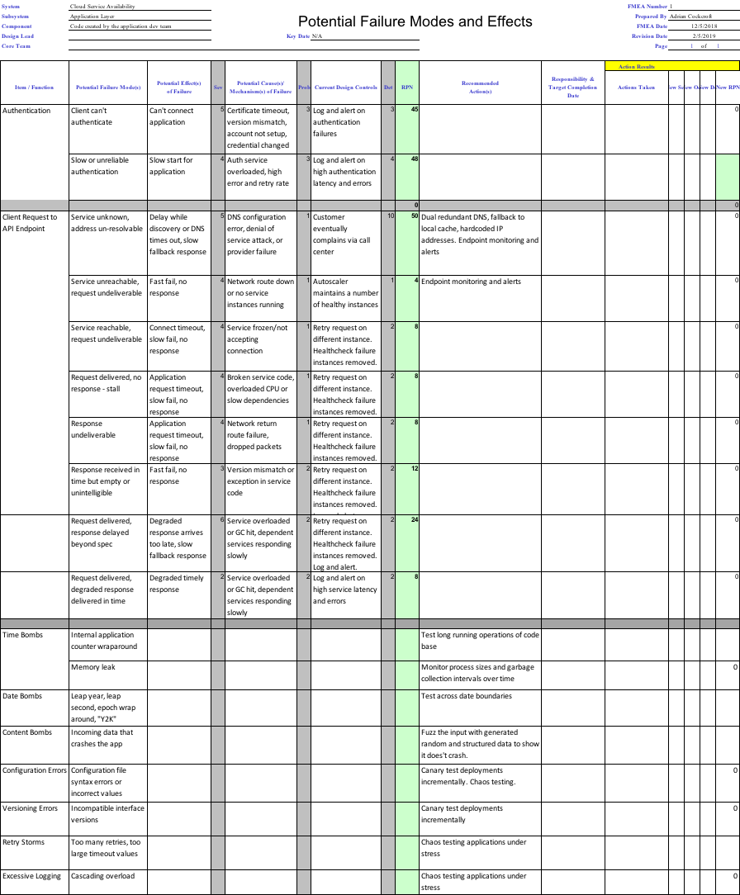
Failure Modes and Effects Analysis - FMEA
Systematic technique taught to mechanical and electrical engineers, but not to software engineers?

Slide 34
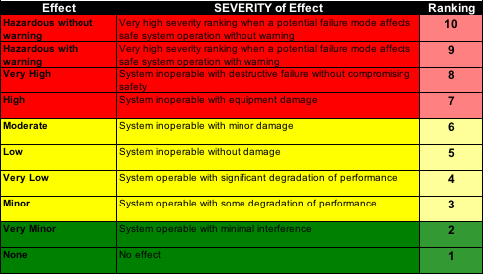
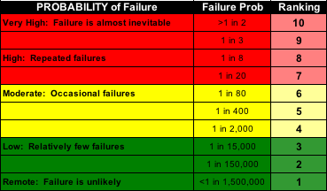
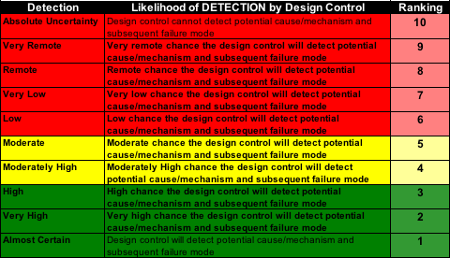
FMEA Severity, Probability, Detectability Scales
RPN = Risk Priority Number
S x P x D from 1 to 1000
Exponential qualitative scale
1 – no effect, unlikely, see it coming
1000 – certain death with no warning
Detectability usually the easiest to fix

Slide 35
Failure Modes and Effects Analysis - FMEA

Slide 36
Failure Modes and Effects Analysis - FMEA

Slide 37
Failure Modes and Effects Analysis - FMEA

Slide 38

Thank You github.com/adrianco/slides
Adrian Cockcroft
@adrianco
© 2018, Amazon Web Services, Inc. or its Affiliates. All rights reserved. Amazon Confidential and Trademark

